Slide 1
LSTM model
time series anomaly detection

Slide 2
Basic Long Short Term Memory (LSTM)
Model type
application
LSTM is a type of RNN deep learning Units that is mostly used for analysis of sequential data (time series data prediction).
There are different application areas that are used: Language model, neural machine translation, music generation, time series prediction, financial prediction, etc.

Slide 3
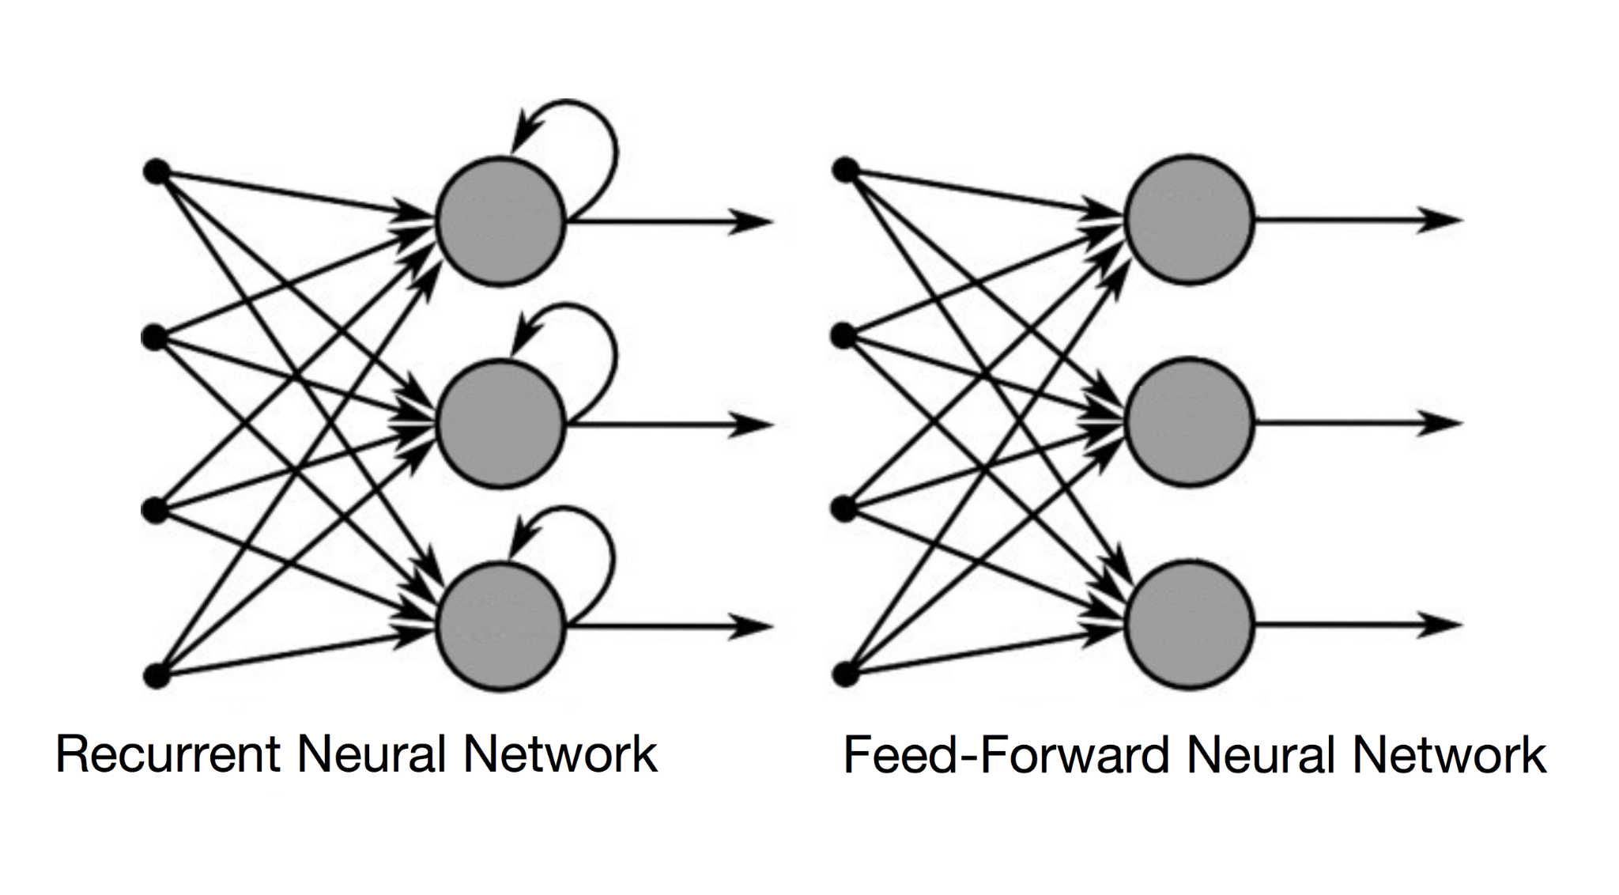
Standard NN
RNN

Slide 4
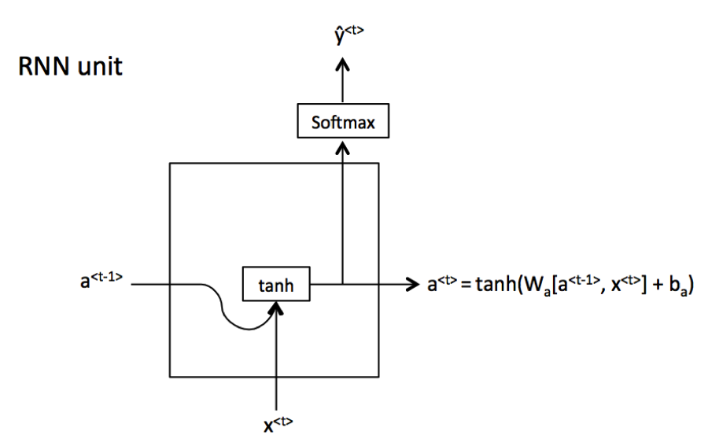
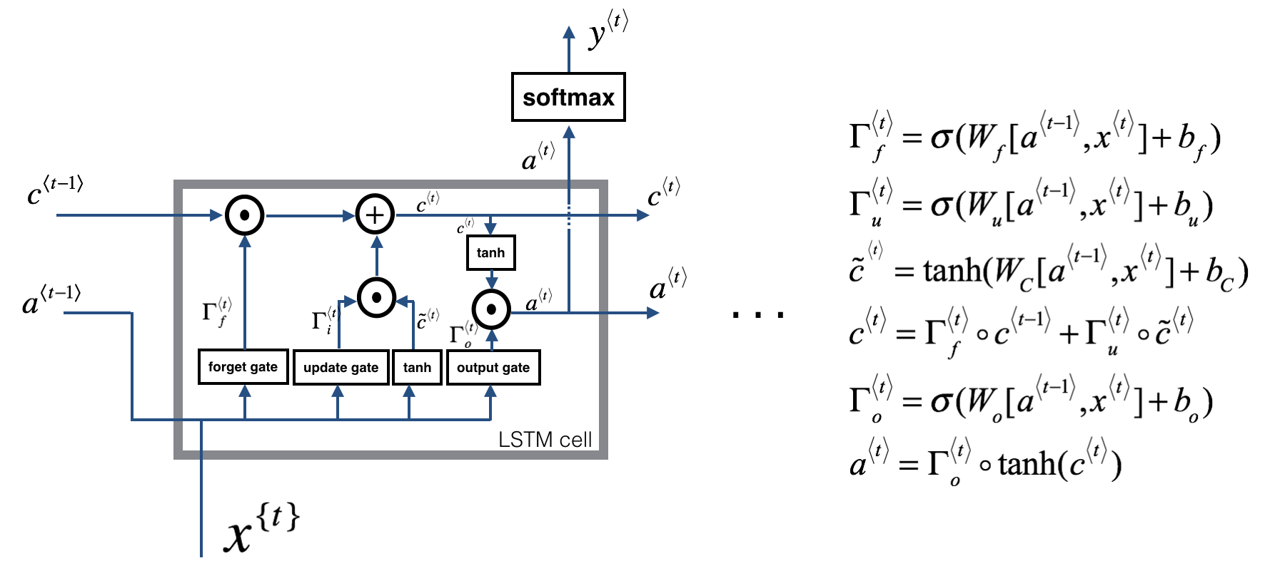
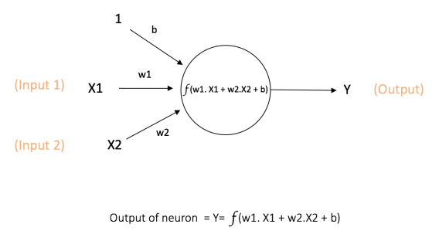
Types of NN
Standard NN
RNN
RNN with LSTM unit

Slide 5
LSTM Cell
Type of RNN units

Slide 6
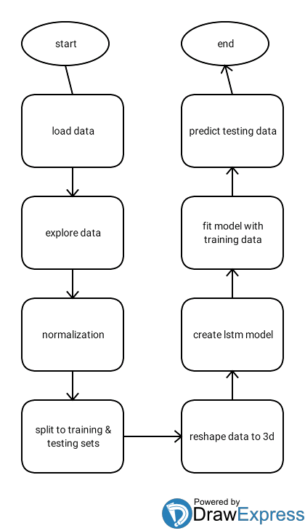
Code flow chart

Slide 7
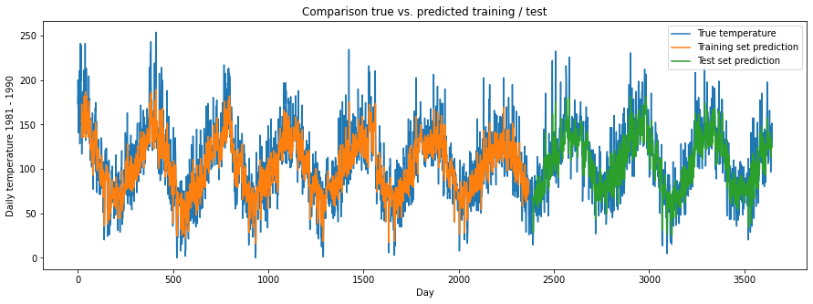
Results Dataset 1

Slide 8
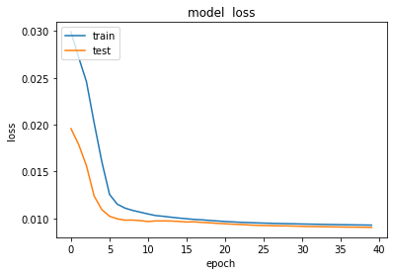
Loss
RMSE
Training data score= 23.87 RMSE
Testing data score= 23.15 RMSE

Slide 9
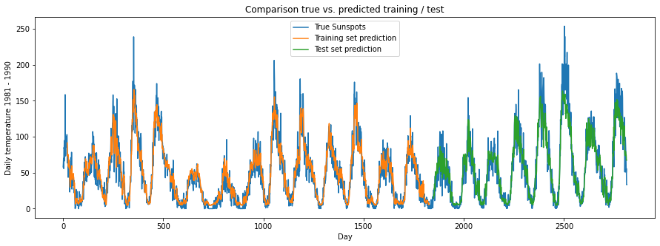
Results dataset 2

Slide 10
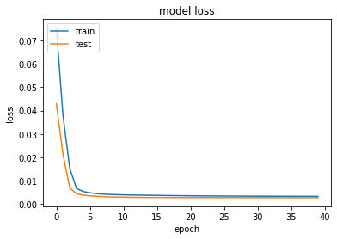
Loss
RMSE
Training data score= 13.86 RMSE
Testing data score= 18.49 RMSE

